Slide 1
CT-216
LDPC DECODING FOR 5G NR
Lab Group - 1, Sub Group - 3
Under Guidance of : Prof. Yash Vasavda
Mentor TA: Mr. Harshneel

Slide 2

HONOR CODE
We declare that:
The work that we are presenting is our own work.
We have not copied the work (the code, the results, etc.) that someone else has done.
Concepts, understanding and insights we will be describing are our own.
We make this pledge truthfully. We know that violation of this solemn pledge can carry grave consequences.

Slide 3
Contents
01
02
03
04
05
About LDPC and 5G NR
Base matrix and Parity Check matrix
Code Rate Matching
Encoding
BPSK Modulation and AWGN Channel
06
07
08
09
10
Hard Decision Decoding
Soft Decision Decoding
Results
Comparison with Shannon’s Bound
Conclusion

Slide 4
About LDPC Codes
A type of linear block code introduced by Robert Gallager in 1960s.
Have a special characteristic of sparse H matrix.
Offer exceptional suitability for 5G NR shared channels like:
Minimal latency,
Low decoding complexity
Remarkable rate compatibility
Very low error rate
LDPC codes are adaptable to various block sizes and code rates, owing to the innovative design of rate-compatible base graphs.

Slide 5



PROGRAM FLOW
Random Message Generated
Parity Check Matrix
Base Matrix
H Matrix
AWGN
BPSK
Encoded Message
Received Message
Received Bits
Soft Decoding
Hard Decoding

Slide 6
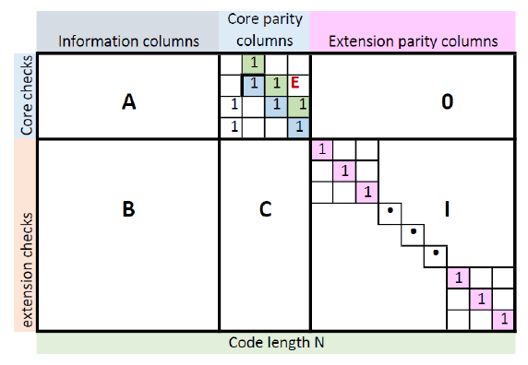
Base Graph Analysis
5G NR makes use of two different sized base graphs, BG1 and BG2, whose usage is determined by the code rate and size of information bits.
BG1 has a size of 46 x 68.
BG2 has a size of 42 x 52.
The number of message bits is determined by k=m-n where the base graphs are of size m x n. Thus,
BG1 has a maximum of 22 bits.
BG2 has a maximum of 10 bits.
Both the base graphs have a distinctive block structure as shown in the figure which can be exploited during encoding.
By having two base graphs, 5G NR LDPC codes can adapt to various data sizes efficiently, ensuring reliable communication across different scenarios.

Slide 7
Parity Check Matrix Generation
To construct the parity check matrix H from the base graph B we use z, which is the lifting size or the expansion factor, which can be determined for every base graph, and make use of the following rules :
Every element in B having value -1 is replaced by a z x z sized all zero matrix.
Every element in B having value 0 is replaced by a z x z sized identity matrix
Every element in B having values from 1 to z - 1 is replaced by the z x z identity matrix circularly shifted right Bᵢ,ⱼ times where Bᵢ,ⱼ is the value of the element in B.

Slide 8
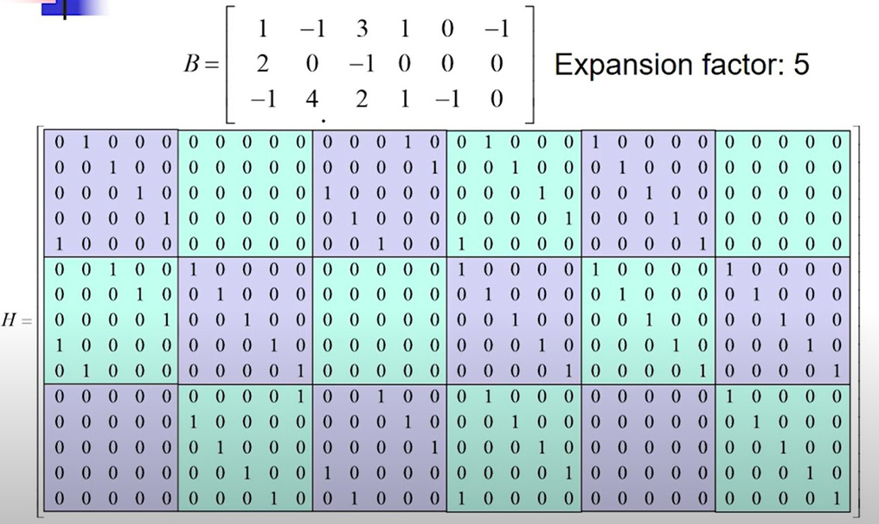
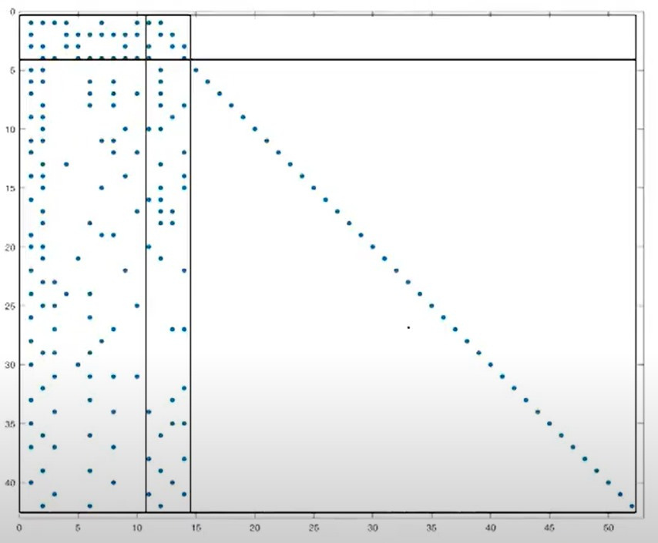
Base Matrix
to
H Matrix
Base Matrix

Slide 9
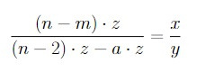
CODERATE MATCHING
Rate matching is a technique used in Low-Density Parity Check (LDPC) codes to adjust the code rate of the LDPC code to match the desired transmission rate of the communication system.
Suppose you have a base matrix of size m x n and an expansion factor of z. So the possible length of the codeword will be n*z.
Out of these n*z bits, the first 2z are always punctured. So we have (n-2)*z bits left.
Suppose you want to achieve an overall code rate of x/y:
Assume that you puncture a*z bits out of the available (n-2)*z bits.
Number of message bits = (n-m) * z.
From the equation shown, we can compute the number of parity bits required.
So, the required size of H matrix is:
Number of rows = Number of parity bits which we get from the equation
Number of columns = Number of columns from equation + 2.
Let’s consider one example ahead for better understanding.

Slide 10
CODERATE MATCHING EXAMPLE
Suppose we have a 46 X 68 Base matrix and we want a code rate of 2/3.
So, n = 68, m= 46, x = 2, y = 3. Putting these values in the previous equation and solving for a, we get a = 33.
So, now we have to transmit 66z - 33z = 33z bits in all.
Out of these 33z bits, 20z are message bits. Thus, we send 13z parity bits.
Number of rows of B matrix used = 13 rows
Number of columns of B matrix used = 33 + 2 = 35
So, for a code rate of 2/3 we use 13 X 35 entries of the B matrix.
68
13
46
35

Slide 11
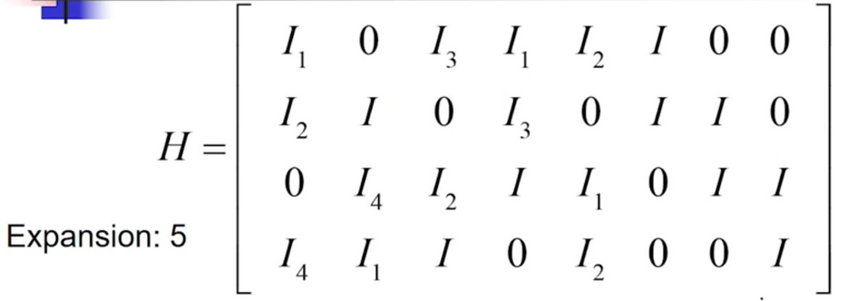
ENCODING USING BASE MATRIX
We exploit the structure of the base matrix to do the encoding.
The main idea behind the decoding is that all the parity bits greater than equal to 5 can be obtained simply by solving a linear equation because of the structure of the matrix.
To find the first four bits, we need to solve 4 equations simultaneously. This calculation is made easy due to the double-diagonal structure of the matrix.
We will consider an example to understand the encoding:
We have a message vector m = [m1 m2 m3 m4 m5]
4 parity bits are added to this vector which are [p1 p2 p3 p4]
Codeword = [c1 c2 c3 c4 c5 c6 c7 c8 c9]
The base matrix is given as follows:
Double - Diagnol Structure
Ik shows the 5 x 5 identity matrix
right shifted k times.
0 represents a 5 x 5 all zeros matrix

Slide 12
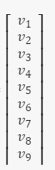
Equations obtained:
I₁v₁ + I₃v₃ + I₁v₄ + I₂v₅ + Iv₆ = 0 -Equation 1
I₂v₁ + Iv₂ + I₃v₄ + Iv₆ + Iv₇ = 0 -Equation2
I₄v₂ + I₂v₃ + Iv₄ + I₁v₅ + Iv₇ +Iv₈ = 0 -Equation 3
I₄v₁ + I₁v₂ + Iv₃ + I₂v₅ +Iv₈ = 0 -Equation 4
Adding all four equations:
I₁v₅ = I₁v₁ + I₂v₁ + I₄v₁ + Iv₂ + I₄v₂ + I₁v₂ + I₃v₃ + I₂v₃ + Iv₃ + I₁v₄ +
I₃v₄ + Iv₄
We know that [v₁ v₂ v₃ v₄ v₅ v₆ v₇ v₈ v₉] =
[m₁ m₂ m₃ m₄ m₅ p₁ p₂ p₃ p₄]
So, rewriting the equation, we get:
I₁p₁ = I₁m₁ + I₂m₁ + I₄m1 + Im₂ + I₄m₂ + I₁m₂ + I₃m₃ + I₂m₃ + Im₃ + I₁m₄
+ I₃m₄ + Im₄
From here we can get p₁.
Substitute it in equation1 to get p₂ and solve so on to get all the 4 parity bits
The encoded message must satisfy the equality H*c = 0.

Slide 13
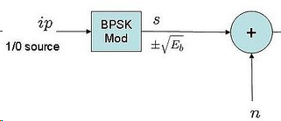
BPSK MODULATION AND NOISE
The encoded output is then passed to the BPSK modulator which converts the matrix of encoded bits to the matrix of encoded symbols(1,-1).
1 → -1
0 → 1
These encoded symbols when passed through the AWGN channel further add noise to the channel.
Variance of noise added = σ = 1/√ (2 * Eb_No * r)

Slide 14
HARD DECISION DECODING

Slide 15
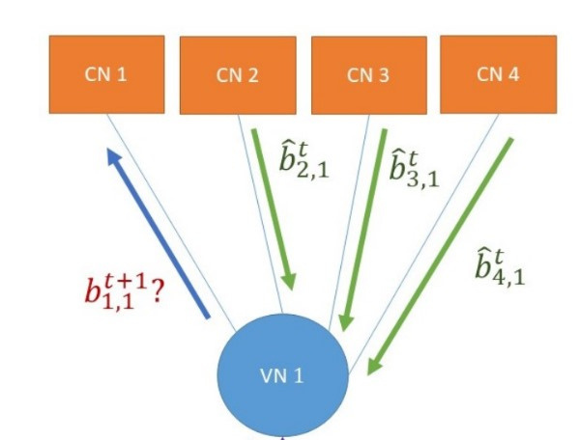
HARD DECISION DECODING ALGORITHM
VN to CN Message Passing
First we load all the received values into the VN.
Then, for first iteration:
We directly send the received value to all connected CNs of respective VNs.
For all other iterations:
To send message to CN i, we take all the messages received to VN j and the bit it had originally, except value sent by CN i. Then we perform majority voting of these messages and send it to CN i.
r

Slide 16
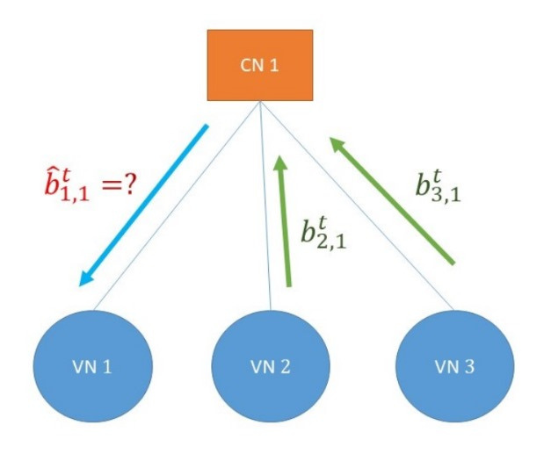
HARD DECISION DECODING ALGORITHM
CN to VN Message Passing
Since each CN is a SPC code, the algorithm to send the message from CN to VN is simple performing an XOR operation .
We take all the values received from the connected VNs except that sent by VN j. Then we take the xor of these values and send the message to VN j.
To make the code efficient, we initially took XOR of all the messages received from each VN. The, to send the message to VN j, we again took the xor of the total with the message sent by VN j, and sent back that value.

Slide 17
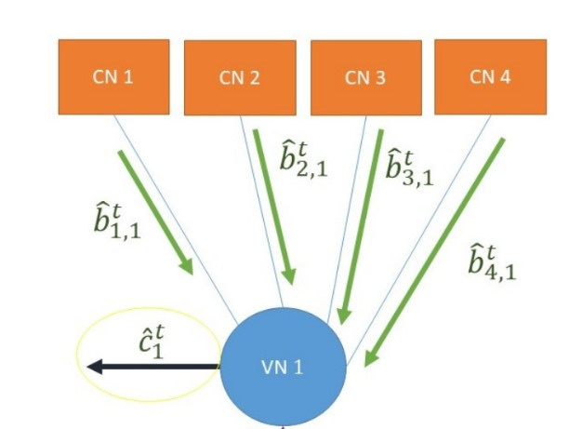
HARD DECISION DECODING ALGORITHM
Computing ĉ
After 1 complete iteration, we now estimate ĉ. Each bit of ĉ is determined by majority voting.
Majority voting of all the messages received from each connected CN and the original message gives each bit of ĉ.
We keep on doing these iterations until we reach the maximum iterations allowed or the estimated ĉ equals the encoded codeword or ĉ equals the last estimated codeword.
r

Slide 18

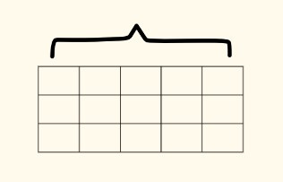
MAP GENERATION
To implement the explained algorithm in MATLAB, we have made two cells named VN_to_CN_Map and CN_to_VN_Map. These maps remain same for both Soft Decision and Hard Decision Decoding.
Following is the explanation of these maps:
The first map shows that Cni is connected to 4 VNs - VN1, VN2, VN5, VN6 and VN 7.
We can also see that since our H matrix is non-regular, the number of VNs connected with all CNs is not equal.
Similarly, we have constructed a map for VN to CN.
Now using these maps and an L matrix of the size equal to H matrix, we perform the decoding as explained before.
Connected VNS
Connected CNS
CN i
CN i+1
CN i+2
VN j
VN j+1
VN j+2
VN₁
CN₁
x₁
VN₂
VN₅
VN₆
VN₇
x₁
CN₂
CN₅
CN₆
VN₂
VN₅
VN₇
VN₈
CN₂
CN₅
VN₁
VN₅
VN₇
VN₈
VN₁₀
CN₁
CN₅
CN₇
CN₈
CN_to_VN_Map
VN_to_CN_Map

Slide 19
SOFT DECISION DECODING

Slide 20
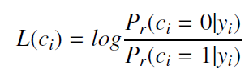
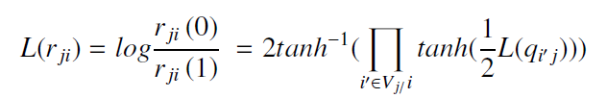
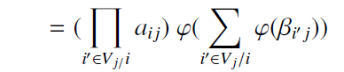
SOFT DECISION DECODING ALGORITHM
The input to the decoder is the received message from the channel which are real values which act as LLRs.
In the first step these LLRs are loaded onto the variable nodes after which message transmission from the Vn to the respective connected Cn takes place. This can be calculated using the following formula.
But calculating this value for every Cn for every iteration can make the algorithm complex, so we implement Min-Sum approximation for message passing from Vn to Cn.

Slide 21
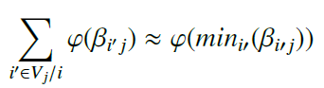
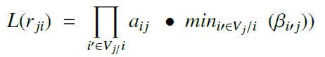
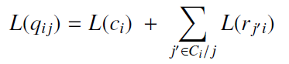
cont.
MIN-SUM APPROXIMATION
Due to the nature of the graph of the function ɸ(x), the sum of values of of all such values is dominated by the smallest value of x, which is:
Thus by employing this Min-Sum approximation , the message passed from CN to VN becomes:
After the CN sends message to VN, every VN also calculate the next message which it will pass to each CN it is connected to. This is given by:

Slide 22
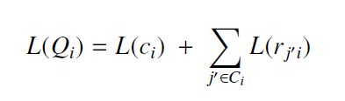
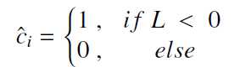
cont.
FINAL DECISION MAKING
After every iteration we calculate the Ĉ, which is the decoded message after every iteration. To do this we find:
Through this value we can find the bits using the following method:
We have the final decoded Ĉ if either we have already completed the maximum number of iterations or when H*Ĉ=0.

Slide 23
ALGORITHM IMPLEMENTATION
To implement the Soft decision decoder in MATLAB, we made use of the parity matrix H, where each row denotes a Check node and each column represents a Variable Node, and the 1's in H matrix at position h(i,j) represents and edge between the CN numbered i and VN numbered j.
Using this model of the tanner graph, we make a copy of H and call it L, and we replace every 1 in L with the received LLR, basically loading every VN with the received LLRs.
We then perform message passing from the CN to VN by employing the Min-Sum approximation algorithm in every row, that is replacing every non-zero value with the minimum of the every other non-zero value and then multiplying with the suitable parity.
After this we perform message passing from the VN to CN by adding every value in each column. This gives us the total LLR which can be used to make the decision and find Ĉ and check if further iterations are required or not.

Slide 24
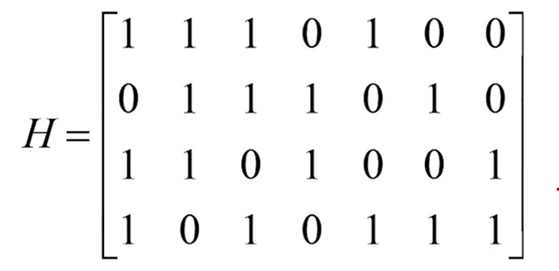
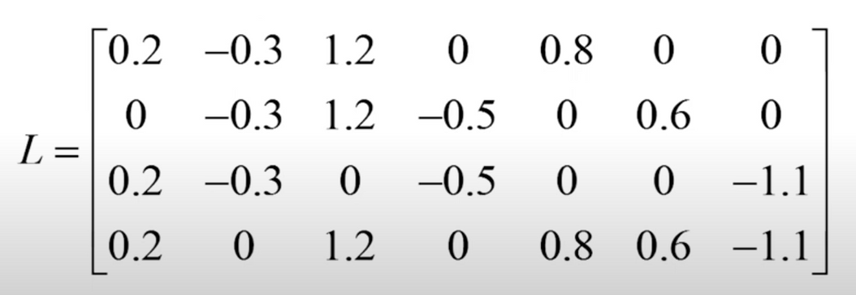
Example for Better Understanding
Suppose we have this H matrix:
The recived vector is:
We make the L matrix as follows:

Slide 25
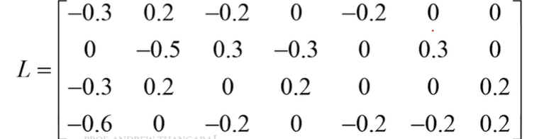
Example for Better Understanding
Calculating min1 and min2 for CN1:
We calculate the minimum of the absolute non-zero values in the row. So min1 = 0.2
and min2 = 0.3. We replace all the non-zero values to min1 and the min1 to min2. Then, we
calculate the overall sign and multiply it with original sign of the bit.
This gives the sign of each element.
Matrix obtained after all the row operations is as follows:

Slide 26
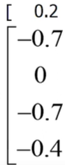
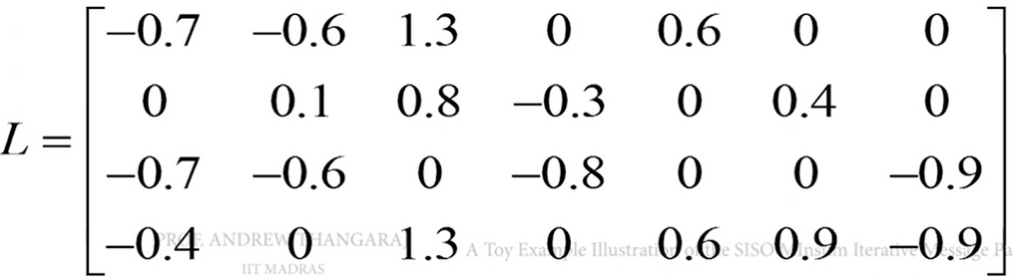
Example for Better Understanding
Now, we calculate the total sum in each column and the received value. This gives the total belief of that bit. r =
New entry in the column = Total sum - Old Entry.
The updated belief after 1st iteration is:
Sum = -1
The updated L matrix is:
We then convert the new vector c
to 0s and 1s and compare it with original
message to check if it is decoded
successfully.
This continues in a loop.

Slide 27
RESULTS OF
MATRIX
NR_2_6_52

Slide 28
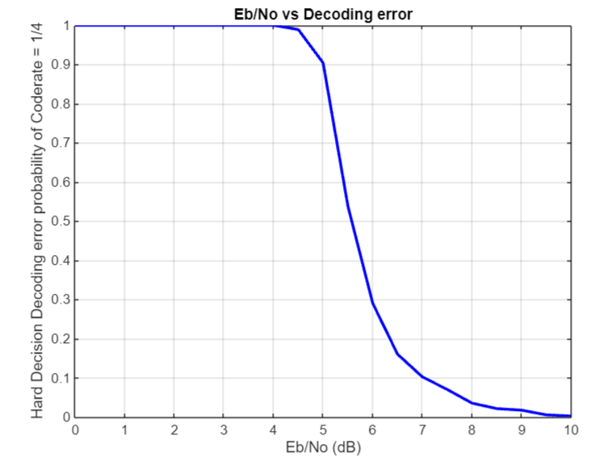
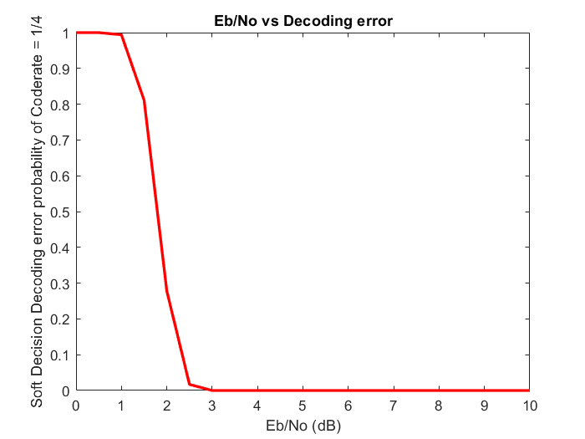
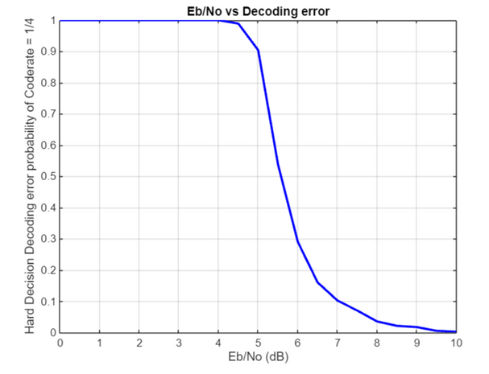
CODE RATE = 1/4
HARD DECISION DECODING
SOFT DECISION DECODING
From this graph we can see that our decoder works perfectly for values of Eb/No greater than 9 for hard decision decoding.
From this graph we can see that our decoder works perfectly for values of Eb/No greater than 3 for soft decision decoding

Slide 29
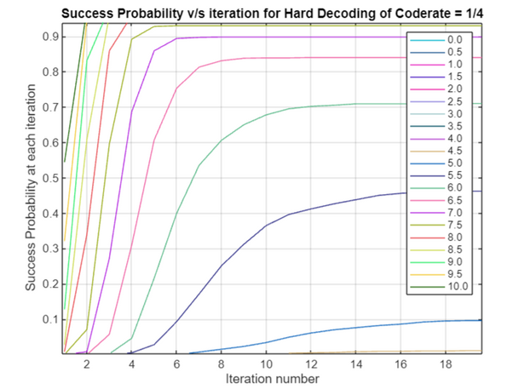
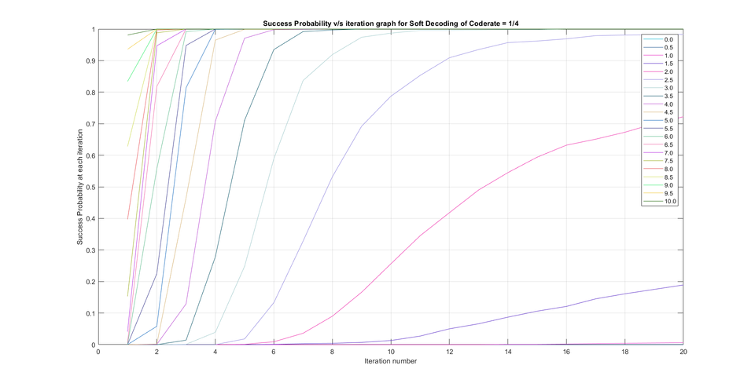
CODE RATE = 1/4
HARD DECISION DECODING
SOFT DECISION DECODING
From this graph we can see that for Eb_No>= 9 db, the decoder decodes all messages successfully, though the number of iterations required differ.
From this graph we can see that for Eb_No>= 3 db, the decoder decodes all messages successfully, though the number of iterations required differ.
When comparing hard and soft decision decoding, we can see that soft decision decoding is better, as for less iteration and less Eb_No value it gives successful results.

Slide 30
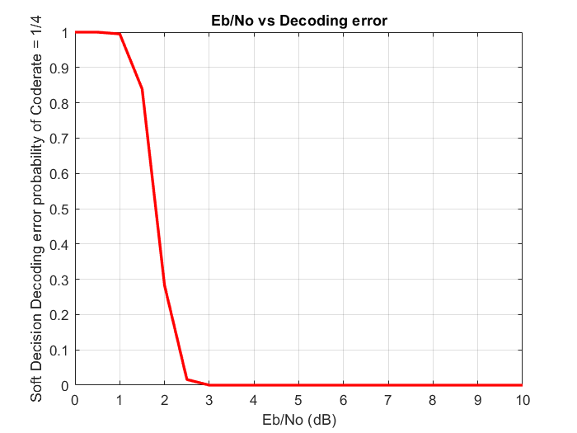
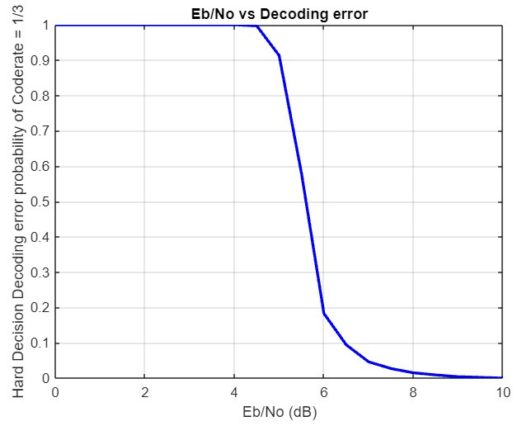


CODE RATE = 1/3
HARD DECISION DECODING
SOFT DECISION DECODING
From this graph we can see that our decoder works perfectly for values of Eb/No greater than 8.5 for hard decision decoding
From this graph we can see that our decoder works perfectly for values of Eb/No greater than 3 for soft decision decoding.

Slide 31
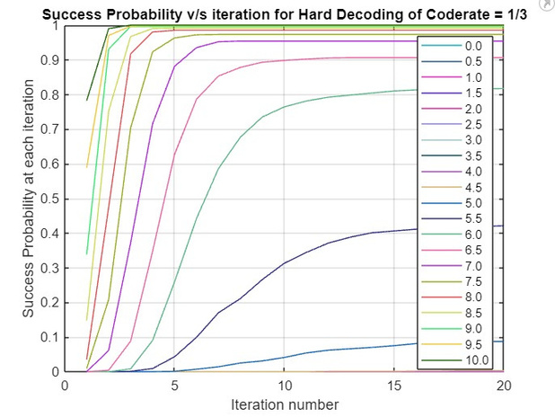
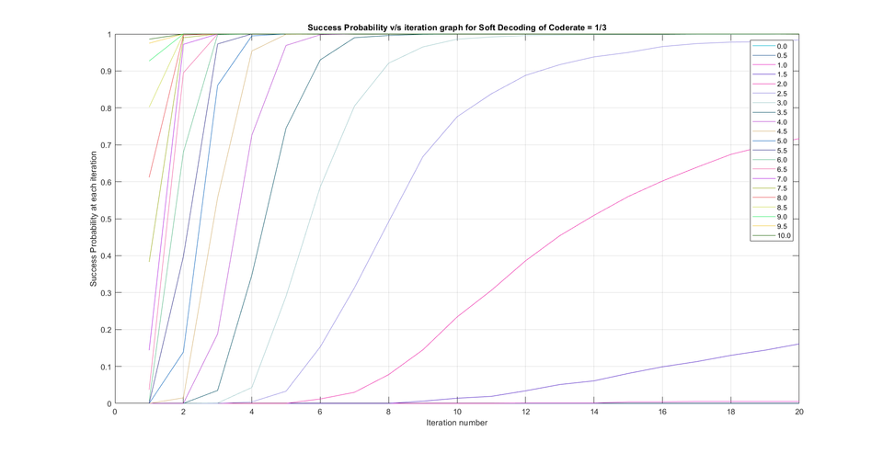
CODE RATE = 1/3
HARD DECISION DECODING
SOFT DECISION DECODING
From this graph we can see that for Eb_No>= 8.5 db, the decoder decodes all messages successfully, though the number of iterations required differ.
From this graph we can see that for Eb_No>= 3 db, the decoder decodes all messages successfully, though the number of iterations required differ.
When comparing hard and soft decision decoding, we can see that soft decision decoding is better, as for less iteration and less Eb_No value it gives successful results.

Slide 32
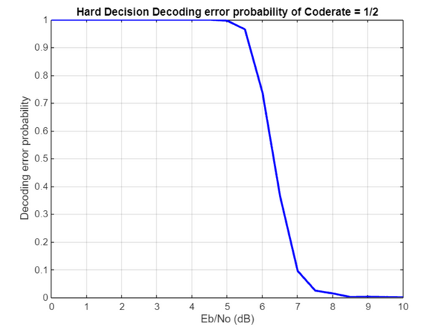
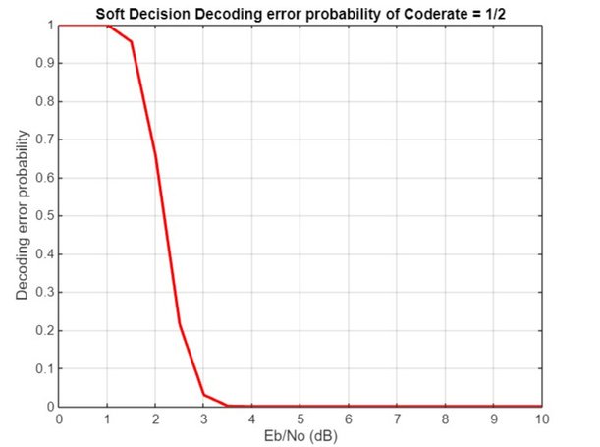
CODE RATE = 1/2
HARD DECISION DECODING
SOFT DECISION DECODING
From this graph we can see that our decoder works perfectly for values of Eb/No greater than 8.5 for hard decision decoding.
From this graph we can see that our decoder works perfectly for values of Eb/No greater than 3.5 for soft decision decoding.

Slide 33
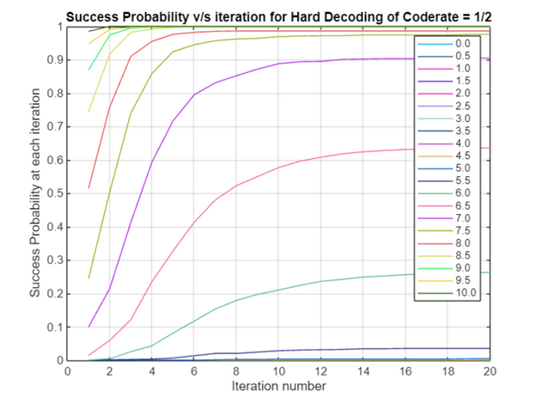
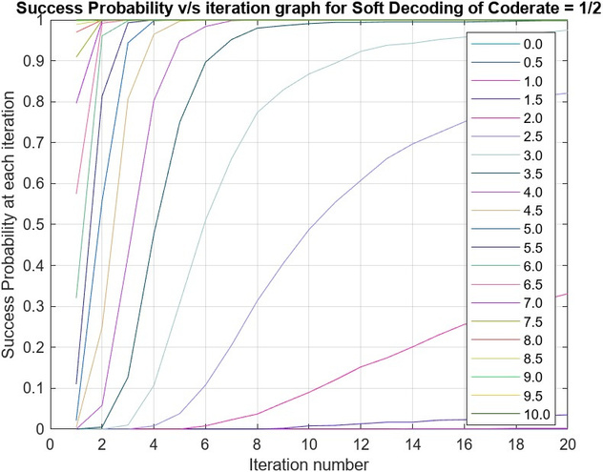
CODE RATE = 1/2
HARD DECISION DECODING
SOFT DECISION DECODING
From this graph we can see that for Eb_No>= 8.5 db, the decoder decodes all messages successfully, though the number of iterations required differ.
From this graph we can see that for Eb_No>= 3.5 db, the decoder decodes all messages successfully, though the number of iterations required differ.
When comparing hard and soft decision decoding, we can see that soft decision decoding is better, as for less iteration and less Eb_No value it gives successful results.

Slide 34
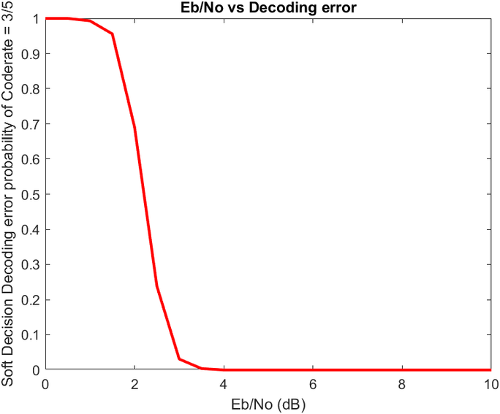
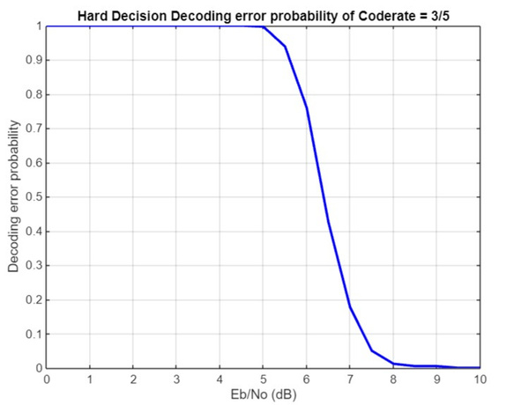


CODE RATE = 3/5
HARD DECISION DECODING
SOFT DECISION DECODING
From this graph we can see that our decoder works perfectly for values of Eb/No greater than 9 for hard decision decoding
From this graph we can see that our decoder works perfectly for values of Eb/No greater than 3 for soft decision decoding.

Slide 35
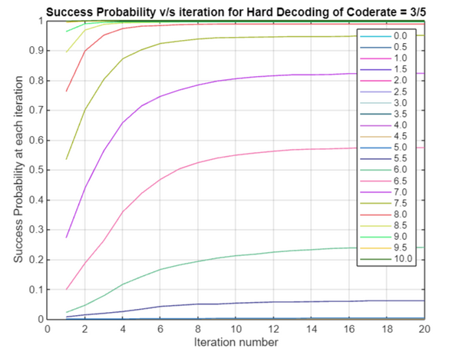
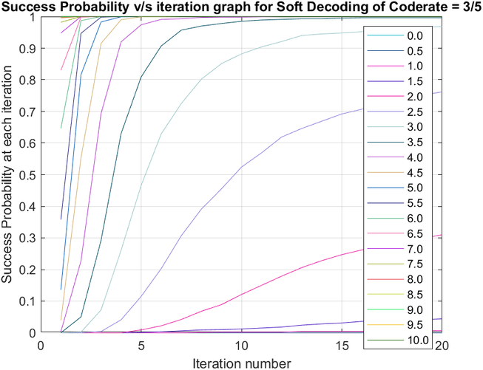
CODE RATE = 3/5
HARD DECISION DECODING
SOFT DECISION DECODING
From this graph we can see that for Eb_No>= 9 db, the decoder decodes all messages successfully, though the number of iterations required differ.
From this graph we can see that for Eb_No>= 3 db, the decoder decodes all messages successfully, though the number of iterations required differ.
When comparing hard and soft decision decoding, we can see that soft decision decoding is better, as for less iteration and less Eb_No value it gives successful results.

Slide 36
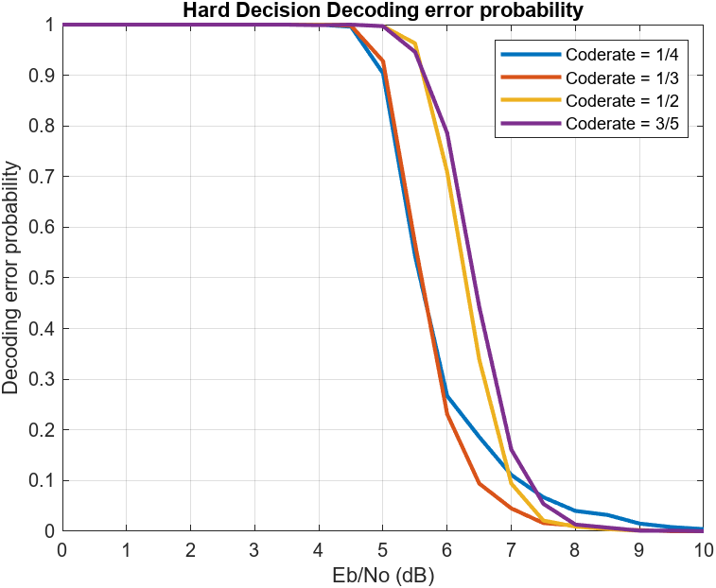
HARD DECISION DECODING
From this graph we can clearly see the comparison between the various code rates. Lower the code rate, more efficient is our channel. This is so because, the number of parity bits increase for lower code rates making decoding more faster and reliable.

Slide 37
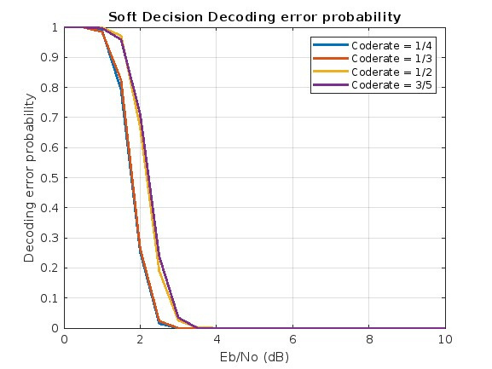
SOFT DECISION DECODING
From this graph we can clearly see the comparison between the various code rates. Lower the code rate, more efficient is our channel. This is so because, the number of parity bits increase for lower code rates making decoding more faster and reliable.

Slide 38
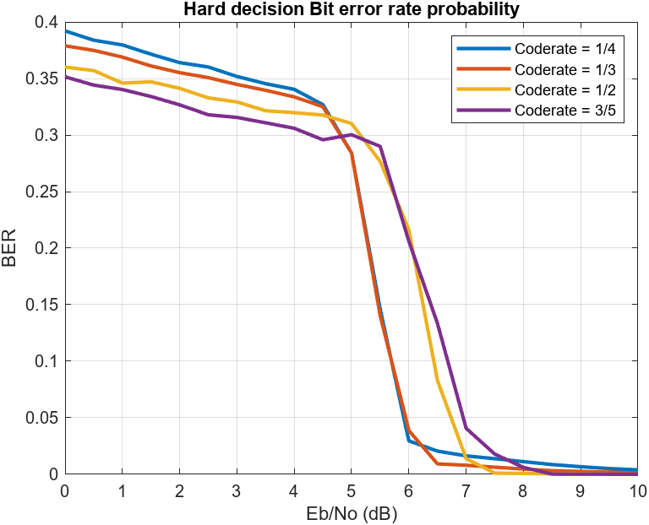
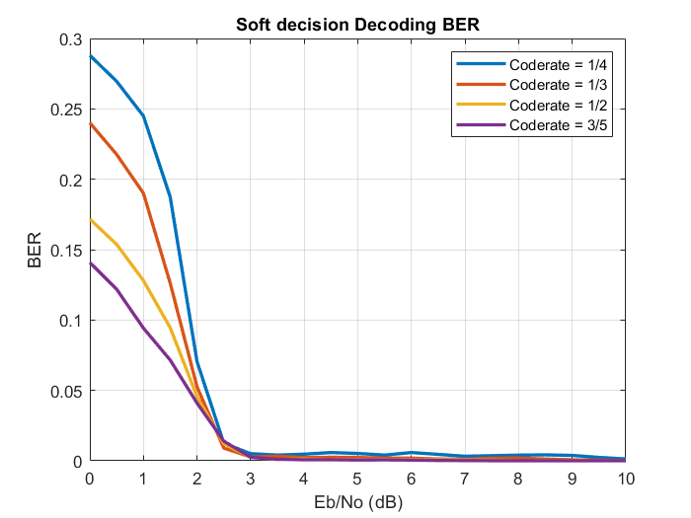
BIT ERROR RATE
HARD DECISION DECODING
SOFT DECISION DECODING
Hard Decision Decoding BER
The number of bits in error decreases drastically once the value of Eb/No goes above around 5 for hard decision decoder.
The value of BER decreases at a much lower value of Eb/No approximately 2.5 for every code rate, which suggest that Soft decision decoders work better at lower SNRs.

Slide 39
RESULTS OF
MATRIX
NR_1_5_352

Slide 40
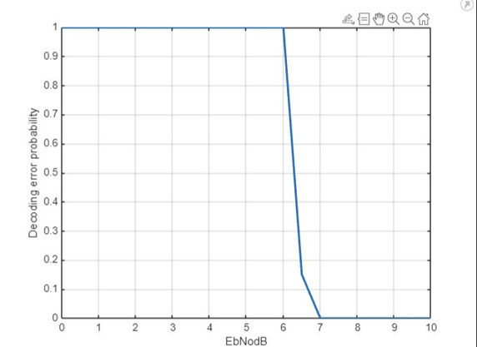
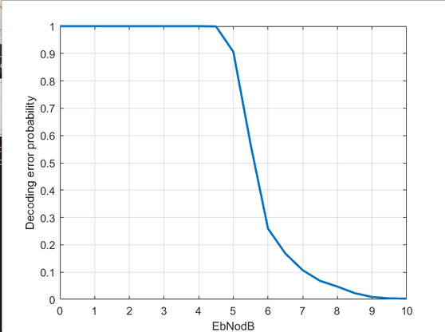
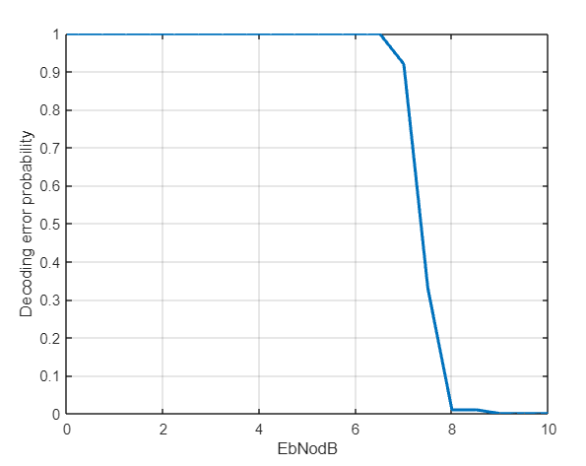
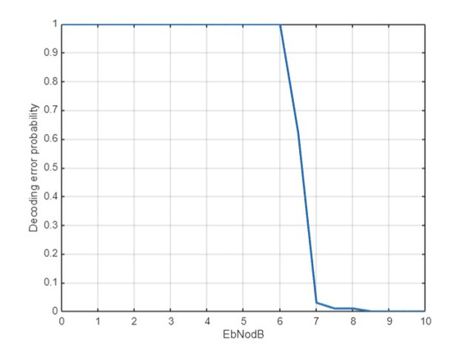
HARD DECISION DECODING
4/5

Slide 41
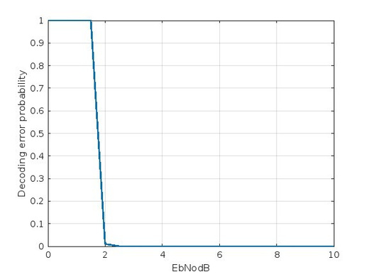



SOFT DECISION DECODING
4/5

Slide 42
COMPARISON WITH SHANNON’S CHANNEL CAPACITY BOUND
Bit error rate is given by the ratio of number of bits in error and total number of bits. According to the Shannon’s bound for Eb/No greater than or equal to 2 the BER is approximately 10⁻⁵.
According to our simulations, for soft decision decoding, we found that the BER will drop to such low values only after Eb/No is greater then 2.5, which is compliant with the Shannon’s channel capacity bound and is quite close to it.
So, we can say that LDPC Codes have a BER quite close to that of Shannon’s bound.

Slide 43
CONCLUSION
From all the results obtained we can conclude that Soft decoding is much more efficient than Hard decoding as it uses the beliefs from other received bits as well.
As the number of iterations increase, the probability of successful decoding also increases.
The efficiency also increases with lower code rate as number of parity bits increases, facilitating faster decoding.

Slide 44
REFERENCES
Lecture Slides of Channel Coding by Professor Yash Vasavada.
Video Lectures of NPTEL-NOM IITM by Prof. Andrew Thangaraj on LDPC codes.
Implementation of Low-Density Parity-Check codes for 5G NR shared channels by LIFANG WANG

Slide 45
TEAM MEMBERS
1 | 202201006 | PATEL KAVAN VIJAYBHAI
2 | 202201015 | MEGHAVI GOHIL
3 | 202201020 | SHRUTI RANJIT CHOUDHARY
4 | 202201024 | HITARTH BHATT
5 | 202201025 | PATEL VIVEK SANJAYKUMAR
6 | 202201026 | TANAY JAIN
7 | 202201029 | BHAVYA MUKESHBHAI KANTELIA
8 | 202201034 | HARSHIT KUMAR
9 | 202201038 | MAHAMMED JAMI
10 | 202201048 | JOSHI SNEH VIPULKUMAR
11 | 202201041 | DHRITI M GOENKA

Slide 46
THANK YOU

